Slide 1
Strategic Directions of Energy Policy and compliance with EU Directives in the field of EE/RE
Ministry of Energy of Georgia
Margalita Arabidze
Local Economic Development FORUM 9th
7 December, 2016

Slide 2
Strategic Directions of Energy Policy
EU Association Agreement Signed
2014
Energy Strategy
currently being developing
Amendment in Georgian law on electricity and natural gas promotion of Net Metering & small scale RE installations
New Energy Policy
2015
implication on EE and RE development
Energy Community Treaty
Signed 2016

Slide 3
Projects promoting Energy Efficiency
Covenant of Mayors with 13 signatories
LEDS - Low Emission Strategy Development
First National Energy Efficiency Action Plan
Consultancy on Energy Efficiency and Sustainable Development in Georgia

Slide 4
CoM Georgian Signatories Cities – 13 Members
Covenant of Mayors in Georgia
8 Sustainable Action Plans/SEAPs
Signatories | Population | Adhesion | Status
Tbilisi, GE | 1.100.000 | 30-Mar-10 | ? | 3
Rustavi, GE | 120.800 | 02-May-11 | ? | 3
Kutaisi, GE | 196.600 | 15-Jul-11 | ? | 3
Batumi, GE | 170.000 | 15-Jul-11 | ? | 3
Gori, GE | 50.400 | 16-Jul-12 | ? | 3
Zugdidi,GE | 76.600 | 01-Aug-13 | ? | 3
Telavi City Hall, GE | 21.800 | 24-Mar-14 | ? | 3
Akhlatsikhe,GE | 19.200 | 31-Oct-14 | ? | 3
Tianeti,GE | 12.900 | 13-Jan-15 | ?
Telavi Municipality, GE | 70.900 | 30-Jan-15 | ?
Kazbegi, GE | 4.900 | 27-Feb-15 | ?
Bolnisi, GE | 76.600 | 16-Mar-15 | ?
Mtskheta, GE | 7.800 | 11-May-15 | ?
Signatories | CO2 target | Analysis Status
Tbilisi, GE | 25%
Rustavi, GE | 24%
Kutaisi, GE | 23%
Batumi, GE | 22%
Gori, GE | 27%
Zugdidi,GE | 24%
Telavi City Hal | 20%
Akhaltikhe City | 21%
Sustainable Energy Action Plans Accepted
Sustainable Energy Action Plans Submitted
- Step1: Signature
- Step2: SEAP Submitted

Slide 5
EC-LEDS
2013- 2016
Municipal Energy Efficiency programs for 10 municipalities
Green Buildings
NEEAP
2015-2016
Based on EED requirement and characteristics of Sectors
EE Policy Measures
Consultancy on EE and Sustainable Development in Georgia
National grid code regulation and standards that enable integration of RE into the national power grid
Energy data MRV, compliant with national and EU standards;
Elaboration of Low Emission Development Strategy of Georgia
Sectoral EE Measures in Power, Industry, Transport, Buildings ad Service
National Energy Efficiency Building Code
Legislation on Labeling of energy related products;

Slide 6
Renewable Energy Development Trends 2012-2016
N | Project | Company | Installed Capacity (MW) | Generation (GWh) | Commencement of Operation (Year)
1 | Khadori 2 HPP | Feri LLC | 5.40 | 30.00 | 2012
2 | Racha HPP | Georgian International Energy Corporation LLC | 11.00 | 45.08 | 2013
3 | Bakhvi 3 HPP | Bakhvi Hydro Power LLC | 10.00 | 35.00 | 2013
4 | Shilda HPP | Energia LLC | 4.80 | 34.50 | 2013
5 | Larsi HPP | Energia LLC | 19.00 | 111.00 | 2013
6 | Aragvi HPP | Energo Aragvi LLC | 8.00 | 50.00 | 2013
7 | Kazreti HPP | Water Energy LLC | 2.50 | 11.00 | 2014
8 | Alazani 2 HPP | Georgian International Energy Corporation LLC | 6.00 | 40.00 | 2014
9 | Akhmeta HPP | Geoenergy LLC | 9.10 | 43.40 | 2014
10 | Kazbegi HPP | Kazbegi HPP LLC | 6.00 | 39.40 | 2014
11 | Paravani HPP | Georgian-Urban Energy LLC | 87.00 | 86.54 | 2014
12 | Pshavela HPP | Stori Power LLC | 1.90 | 9.50 | 2015
13 | Debeda HPP | Hydro Georgia LLC | 3.40 | 10.50 | 2015
14 | Shaqshaqeti HPP | Medgroup Georgia LLC | 1.50 | 7.66 | 2016
15 | Saguramo HPP | Georgian water and Power LLC | 4.4 | 32.00 | 2016
Total |  |  | 180.4 | 909

Slide 7
Wind Energy Utilization
Wind Power Plant KARTLI Commissioned October 6, 1026 Location: Shida Kartli, Gori
Installed Capacity: 20.7 MW
Annual Generation: 88 GWh
Exploitation: October, 2016
Company: JSC GEDF
WPP projects under Feasibility Studies
7 Memorandum of Understanding to explore wind power development potential total installed capacity around 650 MW

Slide 8
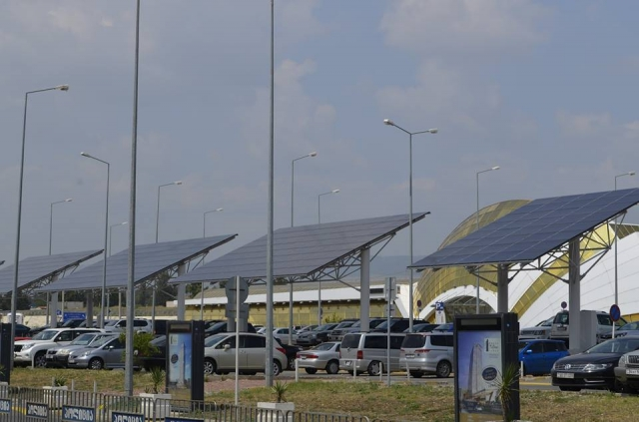
Solar Energy Utilization
Feasibility Studies:
5 MW solar power plant feasibility study is being developed by GEDF;
50 MW solar power plant
feasibility steady is being developed by investor
Operating Solar PVs
Grant from the Japanese government for:
316 KW Solar PV installations at Tbilisi International Airport 337,000 kWh annual generation, covers 40 % of Terminal total consumption
35 KW Solar PV installations at Ilia State University 30,000 kWh annual generation, covers 15% of building’s total consumption

Slide 9
Future Plan
Improvement of existing legislative framework:
Finalization of first NEEAP
Elaboration of:
Energy Efficiency Law
National Renewable Energy Action Plan
In compliance with EU Directives

Slide 10
Thank your for attention!
Margalita Arabidze
Head of Energy Efficiency and Alternative Energy Division
Energy Departament
Ministry of Energy of Georgia
M.Arabidze@energy.gov.ge

